Slide 1
GUIDED CAPSTONE PROJECT PRESENTATION
BIG MOUNTAIN RESORT TICKETING

Slide 2
THE PROBLEM
We set out to find a solution to a simple question:
Can Big Mountain Resort determine what business assets drive customer spending/investment in order to calculate real market value and what sets them apart from the competition so as to balance ticket and service pricing?
After working with the available Data and modeling potential prices based upon a free market, we came to the following recommendations:

Slide 3
RECOMMENDATION & KEY FINDINGS:
We recommend:
A ticket price increase of $1.99 with a potential of increasing to $95.87 give or take $10.39.
Further justifying a ticket price increase with increasing the Resort’s Vertical Drop.
Based on:
Key findings driving price: Vertical Drop, Skiable Terrain, Chair Lifts, Snow Makers, Etc.
Where Big Mountain Resort sits in services provided and prices relative to other states and other resorts within the state of Montana.
The current increase of $1,540,000 per season.

Slide 4
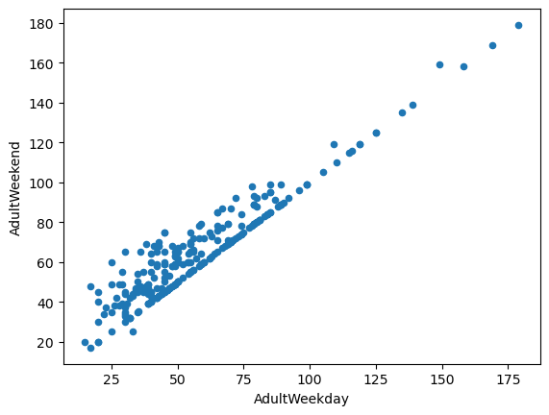
MODELING RESULTS & ANALYSIS (1)
Wrangling:
We used data from our Database. Also in cleaning we discarded unusable or dubious data which couldn’t be externally verified. EX: 2019 which appears to be an opening year when we were looking for years open.
We also opted to only use weekend ticket pricing for modeling purposes due to the strong linear correlation between weekend and weekday prices.

Slide 5
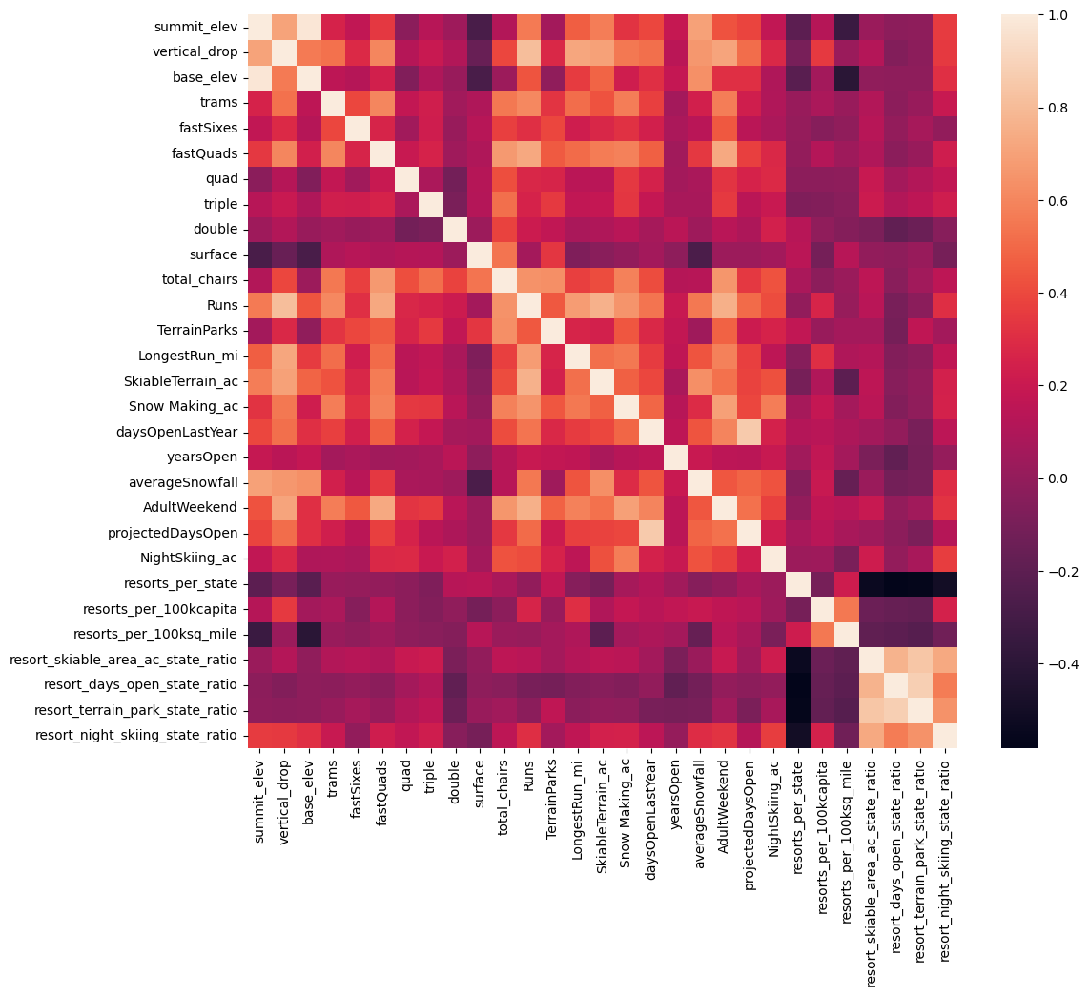
MODELING RESULTS & ANALYSIS (2)
Exploratory Data Analysis:
We examined several numerical features, namely: price, skiable area, night skiable area, # of Fast 4s, (a kind of chairlift), state population, number of resorts per state, and number of resorts per sq kilometer to name a few. We also examined data by comparing these numerical features across states in the hopes that a pattern would emerge.

Slide 6
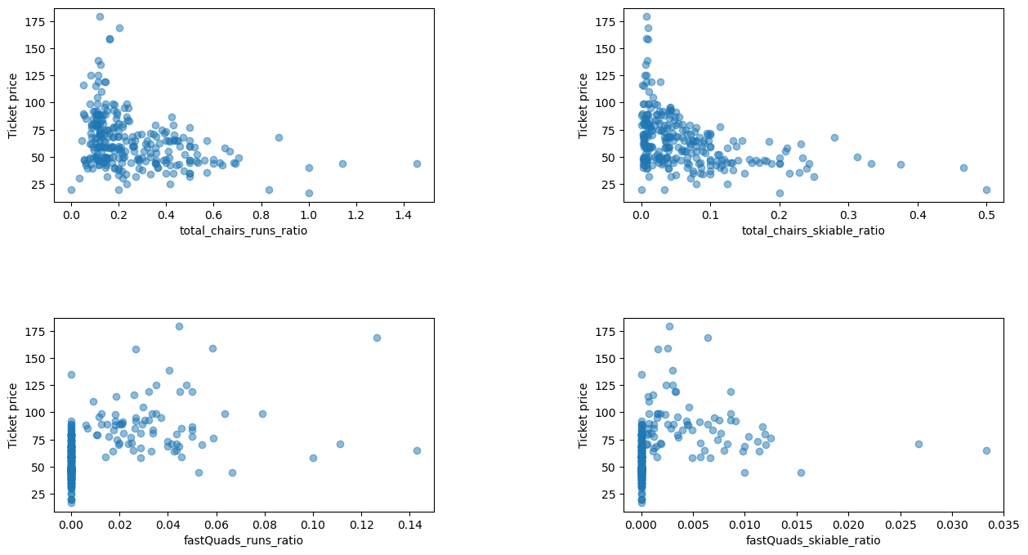
MODELING RESULTS & ANALYSIS (3)
Exploratory Data Analysis (cont’d):

Slide 7
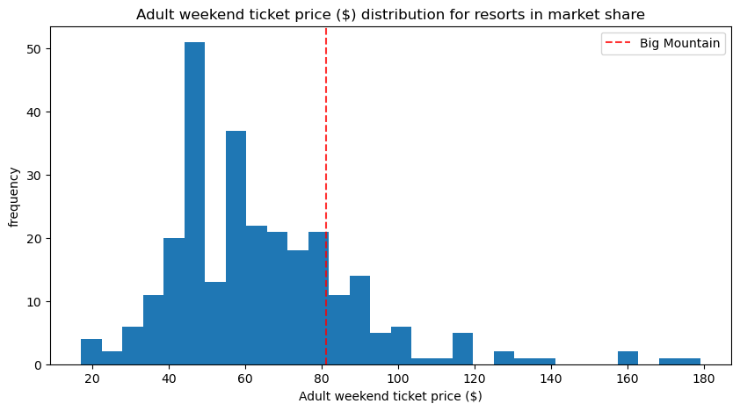
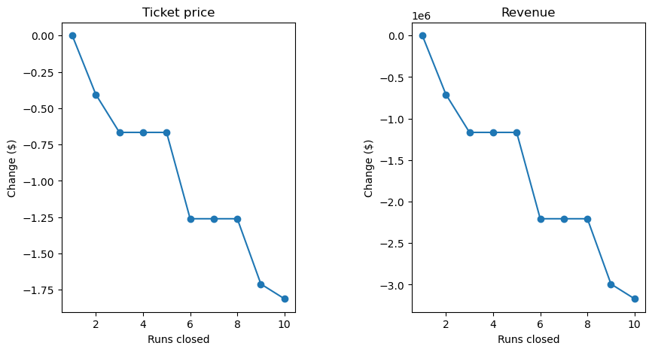
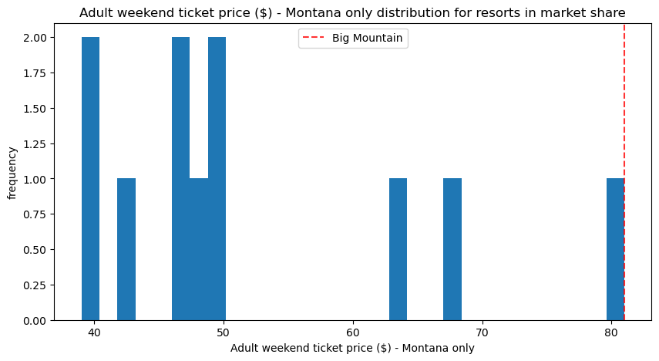
MODELING RESULTS & ANALYSIS (4)
Pre-Processing, Training & Modeling:
We selected the Random Forest Model due to its general application to the problem without being specifically trained. On the left are charts showing where Big Mount rests in both states and Montana and the above graphic contains predictions of lost value from making service cuts to alleviate cost.

Slide 8
CONCLUSION
Based on the results of this project I would recommend:
a $1.99 price increase on the ticket which would result in a $3,474,638 increase in revenue (assuming 5 day tickets.)
This price point would be further justified if the chairlift were used to increase the vertical drop which was one of the strongest key factors in ticket pricing.
Things to consider:
Price can potentially be raised further but sudden drastic changes can result in lost clients both local and distant.
One or plausibly 2 service can be dropped to reduce operating costs however anything further will likely drop the value of the resort and by consequence it’s tickets.
Further Steps:
We would like to scrape for more precise data on competing resorts.
We would also recommend conducting a survey of clients to verify what they believe drives value in the ski resort market.

